Slide 1
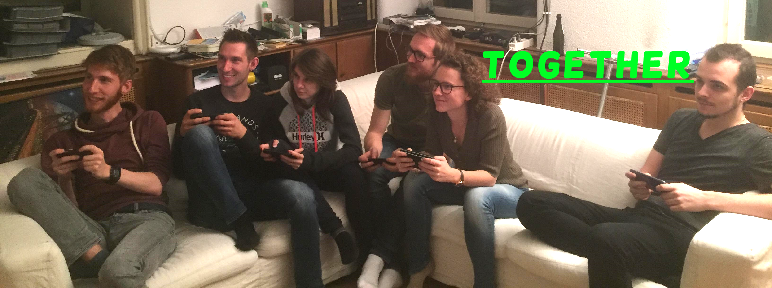
Generic Smartphone Game Controller
Bachelor Thesis
Flückiger Quentin
Notes:
Welcome to presentation of bachelor thesis.
The topic I chose is Generic ….
And I will start this presentation with a little story.

Slide 2
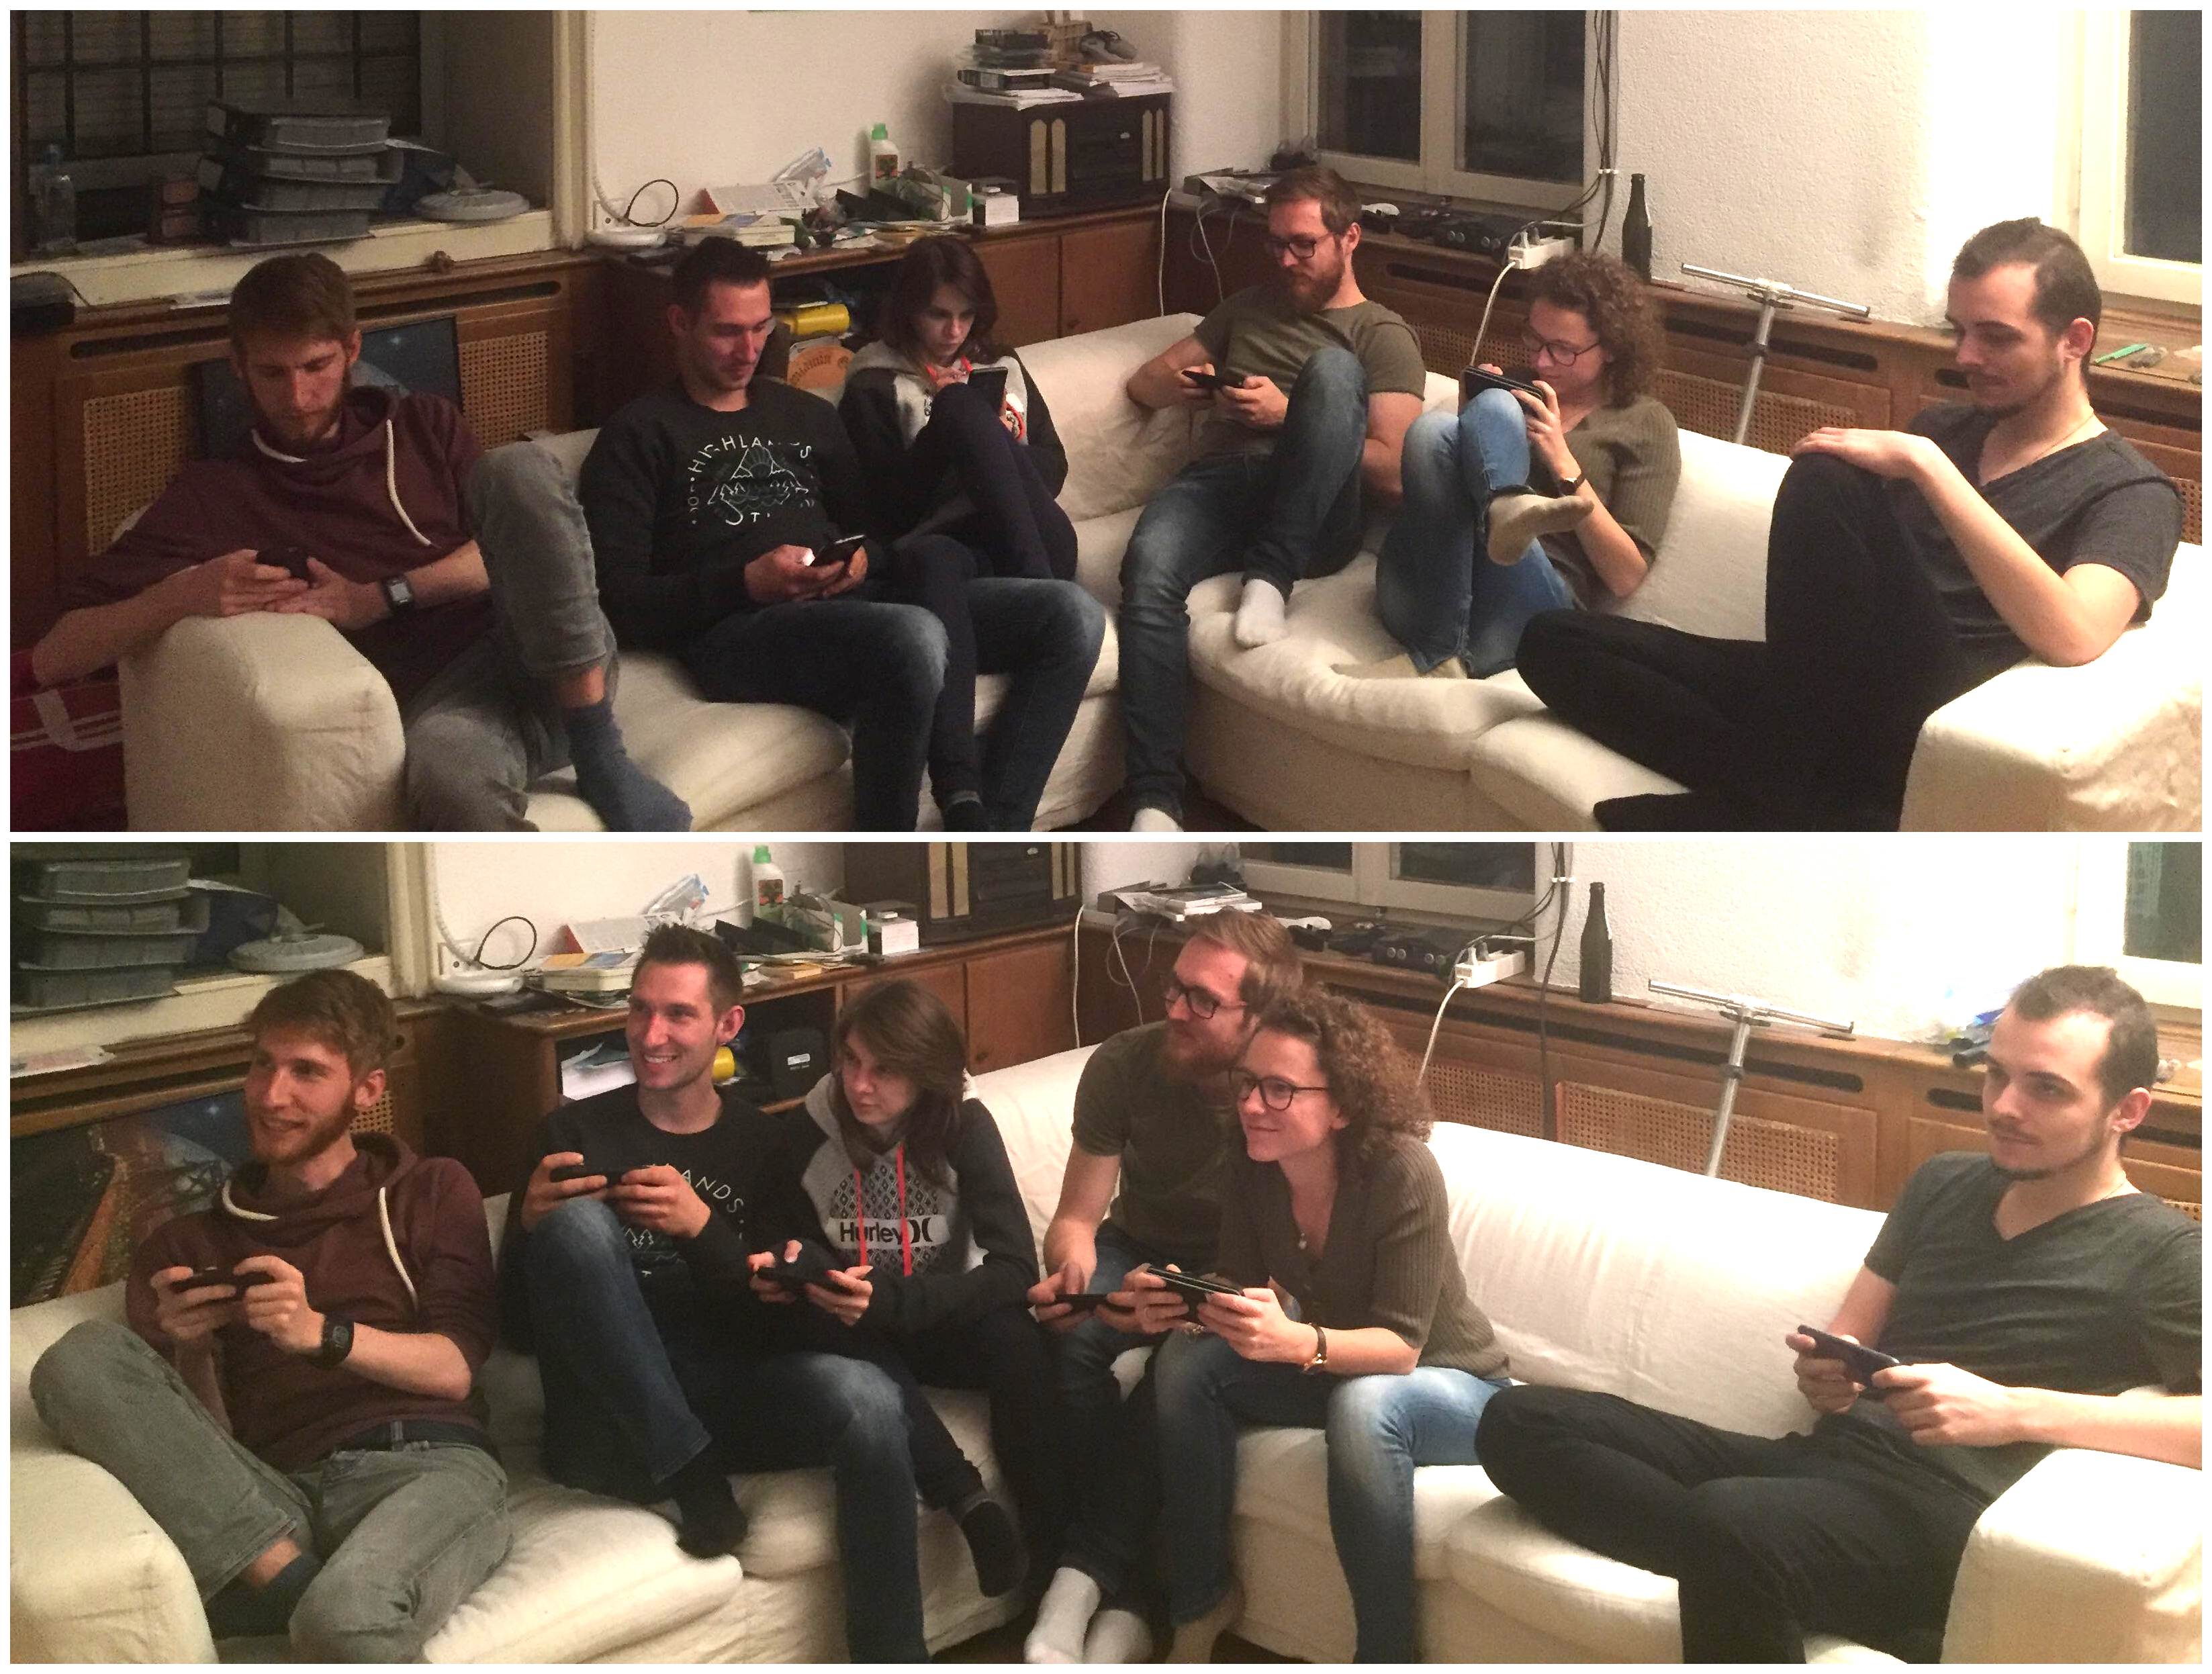
Notes:
Nowadays we very often see people on the streets, in buses, train, pretty much everywhere playing on their smartphone.
Even though those games might be good, they tend to isolate people and make them play in their corner. But what if we would make them play together.
Make them share the moment they are playing those games with others. Playing TOGETHER.
Is there a market for it ? Make it dramatic

Slide 3
Device based comparison
Notes:
If we look in detail at the video game market we can see that the incomes generated by mobile games are around 50% of the globale amount.

Slide 4
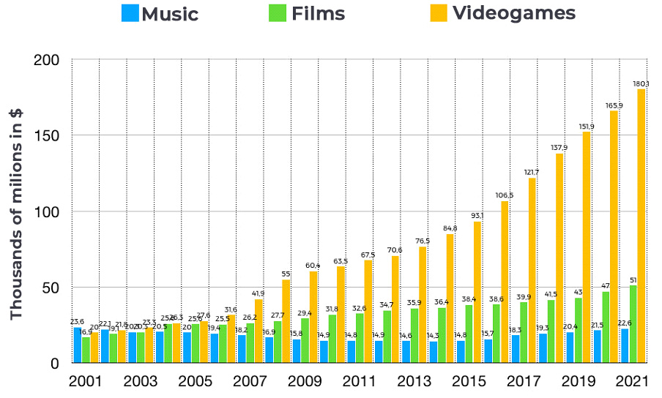
Revenue comparison
Notes:
As you can see on this chart comparing Music, Movies (TV-Show not included) and videogames.
And if we look at the revenue of the digital entertainement industry we can see that video games are far above the other category and is indeed lucrative.

Slide 5
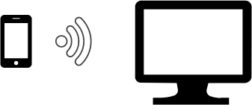
Goals
Use smartphones as a smart controller for video games played on computer
Notes:
But what where actually my goals ?
The main goal was to create a platform which would use smartphones as controllers and a computer screen as the place where the game is being played.
It had to be multiplayer.
I wanted to make this platform generic to allow the possibility to implement more easily games for this software.

Slide 6
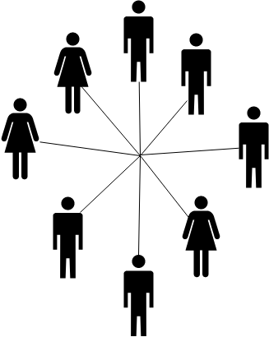
Goals
Use smartphones as a smart controller for video games played on computer
Multiplayer games
Notes:
But what where actually my goals ?
The main goal was to create a platform which would use smartphones as controllers and a computer screen as the palce where the game is playing.
It had to be multiplayer.
I wanted to make this platform generic to allow the possibility to implement more easily games for this software.

Slide 7

Goals
Use smartphones as a smart controller for video games played on computer
Multiplayer games
Generic platform
Notes:
But what where actually my goals ?
The main goal was to create a platform which would use smartphones as controllers and a computer screen as the palce where the game is playing.
It had to be multiplayer.
I wanted to make this platform generic to allow the possibility to implement more easily games for this software.

Slide 8
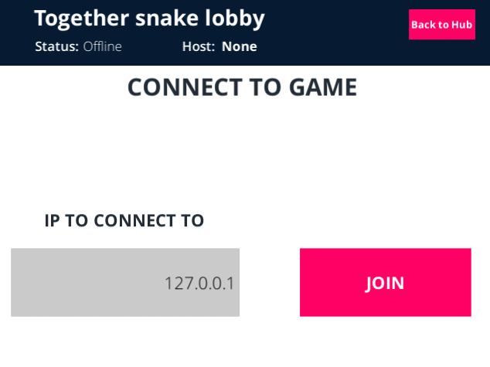
Framework
Using Unity3D
Generic

Slide 9
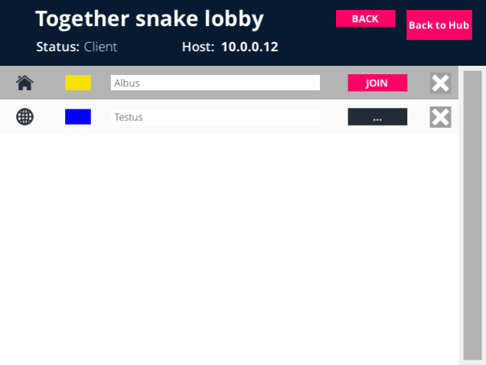
Framework
Using Unity3D
Generic

Slide 10
Framework
Using Unity3D
Generic
Implemented two games as example

Slide 11
Connection
Dedicated server
Connection only possible on same network

Slide 12
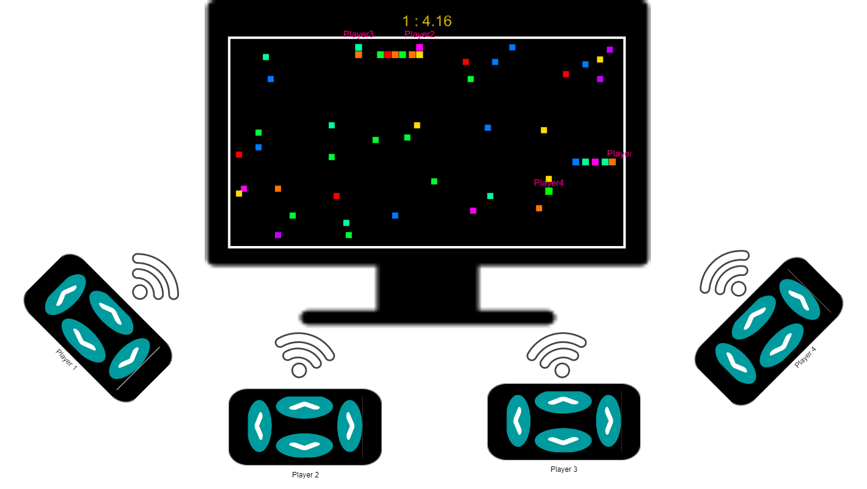
Snake game
1-4 players
Simple rules
Simple controller
Notes:
Snake game: You play as a little snake whose goal is to eat apple to grow bigger, but be aware of the walls and snake tails. No look at controller.
Here 4 players
We could use our phone for more than just basic input data, personal information

Slide 13
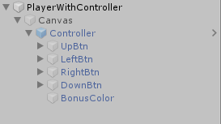
Snake game
Controls
The canvas has to be disabled in the prefab
Notes:
Every players have it’s own set of button linked to the player prefab, it is a canvas that is disabled at start to avoid problem with Unity UI and UNeT, otherwise only the latest player would have a functional UI. Each one of the four buttons works in the same way with just different values. It checks if the snake is the local player

Slide 14
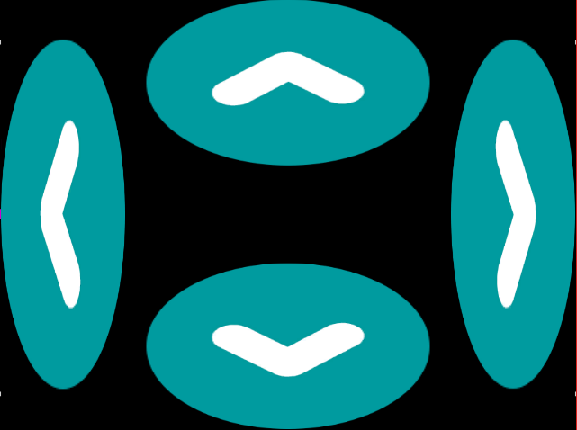
Snake game
Controls
Notes:
Every players have it’s own set of button linked to the player prefab, it is a canvas that is disabled at start to avoid problem with Unity UI and UNeT, otherwise only the latest player would have a functional UI. Each one of the four buttons works in the same way with just different values. It checks if the snake is the local player and the direction the player wants to go isn’t the opposite as the one the snake is facing. If those conditions are met it sets a direction vector to the wanted direction and then use this vector in method invoked repeatidly that moves the snake in thegiven direction on the server.

Slide 15
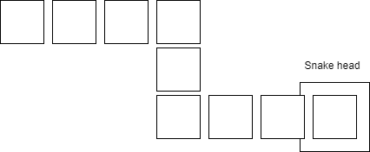
Snake game
Controls
Tail movements
Notes:
Every time we call the stepupdate method on a snake it will call at the same time a method on the tail which handle the movements of it. It first checks if anything was eaten and add it to a list which holds all tail elements from this snake, and then checks if the distance moved by the head was big enough to move the tail. If it is we would then move the last element of the list to the new position and put it as the first element in the list. We would as well disable the box collider component of the two boxes closest to the snake as they would most of the time be located where the heads stands.

Slide 16
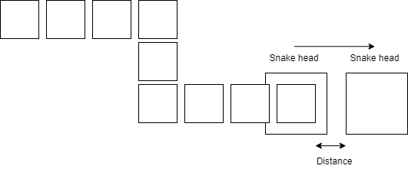
Snake game
Controls
Tail movements
Notes:
Every time we call the stepupdate method on a snake it will call at the same time a method on the tail which handle the movements of it. It first checks if anything was eaten and add it to a list which holds all tail elements from this snake, and then checks if the distance moved by the head was big enough to move the tail. If it is we would then move the last element of the list to the new position and put it as the first element in the list. We would as well disable the box collider component of the two boxes closest to the snake as they would most of the time be located where the heads stands.

Slide 17
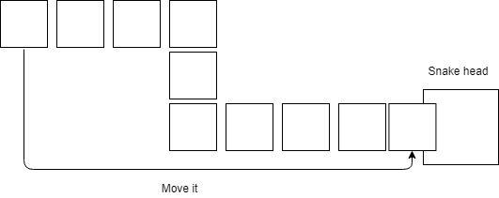
Snake game
Controls
Tail movements
Notes:
Every time we call the stepupdate method on a snake it will call at the same time a method on the tail which handle the movements of it. It first checks if anything was eaten and add it to a list which holds all tail elements from this snake, and then checks if the distance moved by the head was big enough to move the tail. If it is we would then move the last element of the list to the new position and put it as the first element in the list. We would as well disable the box collider component of the two boxes closest to the snake as they would most of the time be located where the heads stands.

Slide 18
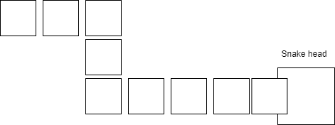
Snake game
Controls
Tail movements
Notes:
Every time we call the stepupdate method on a snake it will call at the same time a method on the tail which handle the movements of it. It first checks if anything was eaten and add it to a list which holds all tail elements from this snake, and then checks if the distance moved by the head was big enough to move the tail. If it is we would then move the last element of the list to the new position and put it as the first element in the list. We would as well disable the box collider component of the two boxes closest to the snake as they would most of the time be located where the heads stands.

Slide 19
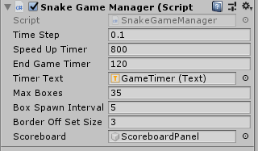
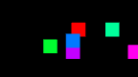
Snake game
Controls
Tail movements
Box spawner
Change game settings
Overlapsing spawning
Notes:
Box spawner will spawn boxes only on the server every x seconds with an invokerepeating method and before spawning the object it will check that the given position is empty of boxes or snake. This is done with a raycast 2D that will check if it hits a collider component. Unfortunatly this tests only at one point, so the boxes can still in rare ocasion overlaps a little bit. This brings us at an unwanted feature of the snake game.

Slide 20
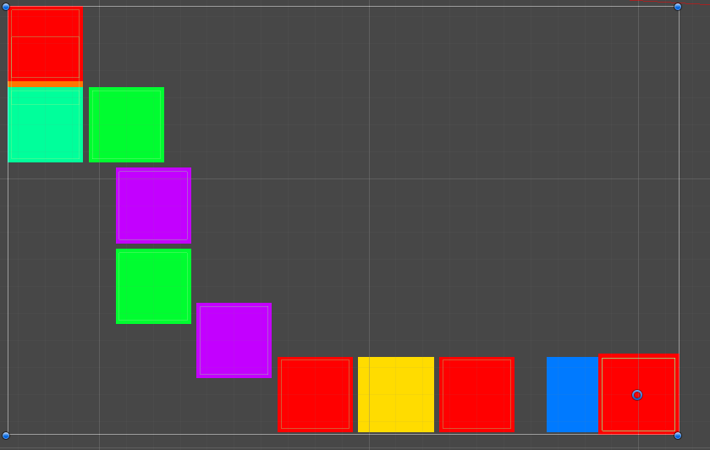
Snake game
Controls
Tail movements
Box spawner
Collisions
Snake tail
Notes:
The collisions are handled with the box collider 2D and we are listening for collision events from the snake with other snake, the walls, the tail elements and the boxes. If it is anything but a box we notify the player controller script that this player died and kill it on the server. If it is a box we eat it and add a new gameboject box to this snake. We could use an object pool instead of destroying and creating the boxes all the time for efficienty. Here comes the problem from before. With the way we are currently moving the tail, when we add more than one box at a time, our snake will «sit» on three box, two will have their collider disable but the the oldest one no, so we will trigger a tail collision and die.
Domino: You have dominos in your hand, cards with two values, and you need to empty your hand by placing them on the board in turn. Here the smartphone is at the core of the game, and you need to look at it during the game.

Slide 21
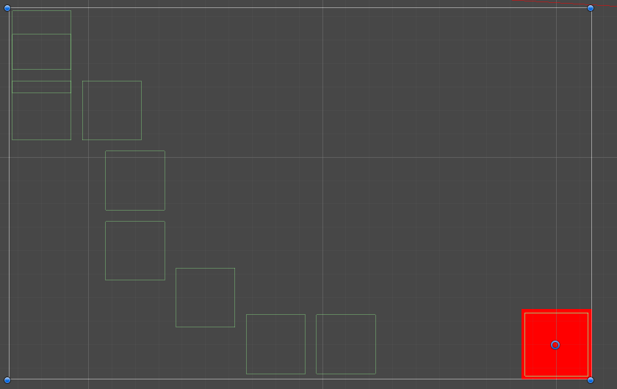
Snake game
Controls
Tail movements
Box spawner
Collisions
Snake tail colliders
Notes:
The collisions are handled with the box collider 2D and we are listening for collision events from the snake with other snake, the walls, the tail elements and the boxes. If it is anything but a box we notify the player controller script that this player died and kill it on the server. If it is a box we eat it and add a new gameboject box to this snake. We could use an object pool instead of destroying and creating the boxes all the time for efficienty. Here comes the problem from before. With the way we are currently moving the tail, when we add more than one box at a time, our snake will «sit» on three box, two will have their collider disable but the the oldest one no, so we will trigger a tail collision and die.
Domino: You have dominos in your hand, cards with two values, and you need to empty your hand by placing them on the board in turn. Here the smartphone is at the core of the game, and you need to look at it during the game.

Slide 22
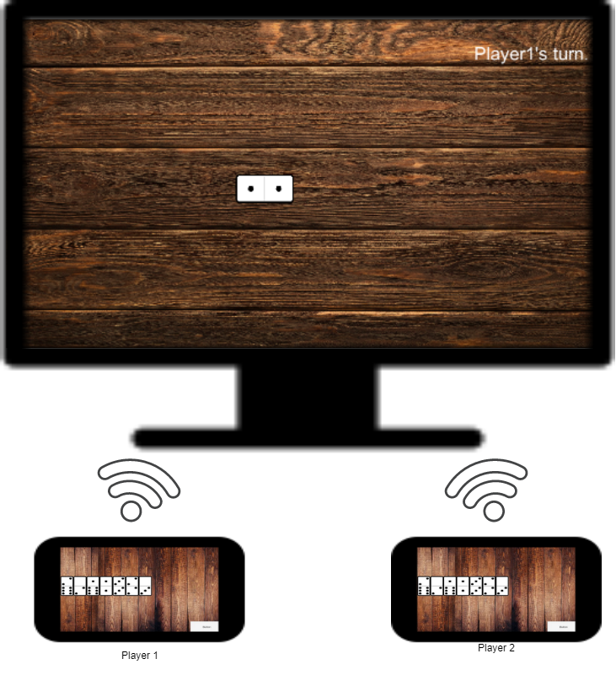
Domino game
2 players
Kind of a card game
Smarter controller
Notes:
Domino: You have dominos in your hand, cards with two values, and you need to empty your hand by placing them on the board in turn. Here the smartphone is at the core of the game, and you need to look at it during the game.

Slide 23
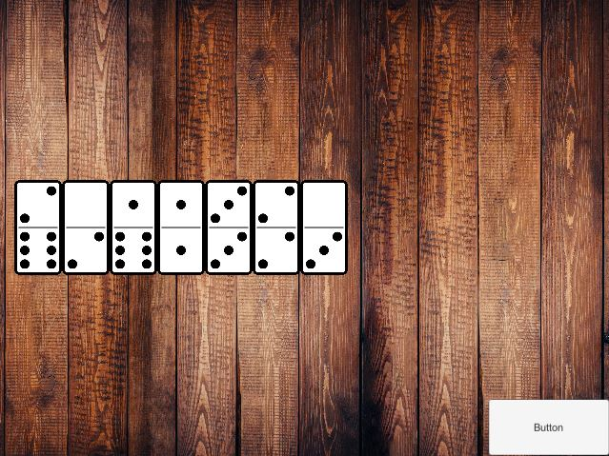
Domino game
Controls
Notes:
Here you can

Slide 24

LLAPI try out
Server
Client
Notes:
Instead of having one projects with both the client and the server, here we have two different projects, one for each. The connection between the two is based on the Network transport and more «customizable», which also means it requires more works than using the HLAPI. But it would have allowed us to create maybe a more suitable network for our needs. And having two different projects would have allowed us to distinguish exactly the server and the client software, instead of having just some preprocessor directives that changes part of the codes and let stuff run in the background hidden behind some canvas. And Unity said the new network will allow projects build with the LLAPI to be transfered. The reason I didn’t continue with this possibility is because I thought it would take too much time and resssource to build the network system from the LLAPI of unity, as I would have had to code all the fundation for my network. If I had chosen this project as project two it would have been most likely different.

Slide 25
Demo

Slide 26
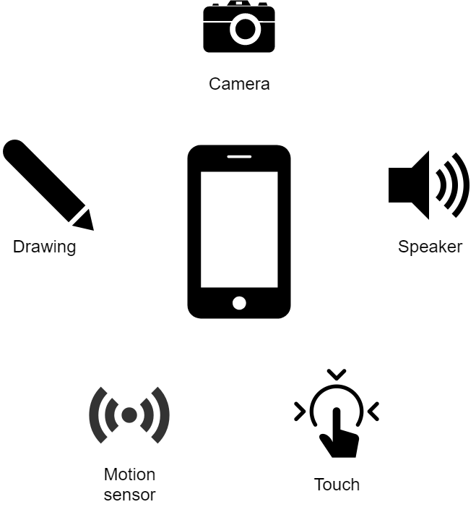
Conclusion
Incredible amount of possibilities
Technical
Notes:
The possibilities using a smartphone as a controller are huge, a game using the motion sensor of the phone could be developed, or the camera, speakers PICTIONARY.

Slide 27
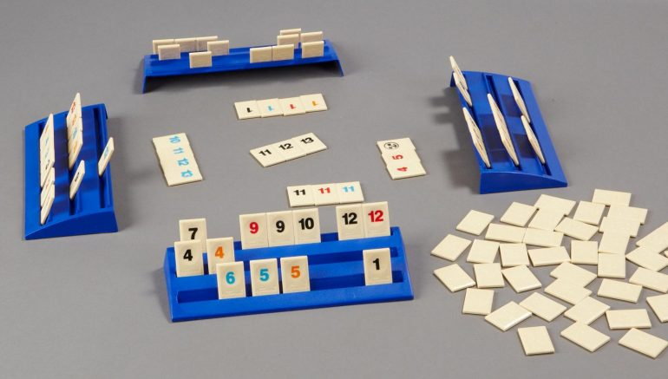
Conclusion
Incredible amount of possibilities
Technical
Conceptual
Notes:
Or conceptual, benefit of having it’s own hidden information. Team game, where information are shared between team members, hide strategy….

Slide 28
Conclusion
Incredible amount of possibilities
Reusability
Notes:
Generic part

Slide 29
Conclusion
Incredible amount of possibilities
Reusability
Throwbacks
Deprecation of UNeT
Android Version / Unity UI
Deployement problems
Notes:
Architecture useless in a while
UI elements not showing on android version 4.4

Slide 30
Conclusion
Incredible amount of possibilities
Reusability
Throwbacks
Other path
Photon
LLAPI
Notes:
Llapi still usefull !

Slide 31
Question(s) ?
Notes:
Thank you for your time and attention

Slide 32
Sources
1. https://lpesports.com/e-sports-news/the-video-games-industry-is-bigger-than-hollywood
2. https://buildfire.com/ios-android-users/
3. https://www.gamesforyoungminds.com/blog/2018/10/15/rummikub-a-classic-rummy-based-tile-game

